Slide 1
Group one members
Name | Index Number
1.
2.
3.
4.
5.
6.
7.
8.

Slide 2

BIKE SHARING PRICE PREDICTION
GROUP ONE

Slide 3

INTRODUCTION GROUP ONE ANALYTICAL GROUP

Slide 4
BIKE SHARING
Bike sharing are new generation of traditional bike rentals where whole process from membership, rental and return back has become automatic.
Through this system users are able to easily rent a bike from a particular position and return back at another position.
Currently, there are over 500 bike-sharing programs around the world which is composed of over 500 thousand bicycles.
Today, there exist great interest in this systems due to their important role in traffic, environmental, social, health issue and not withstanding the revenue they generate for owners.

Slide 5
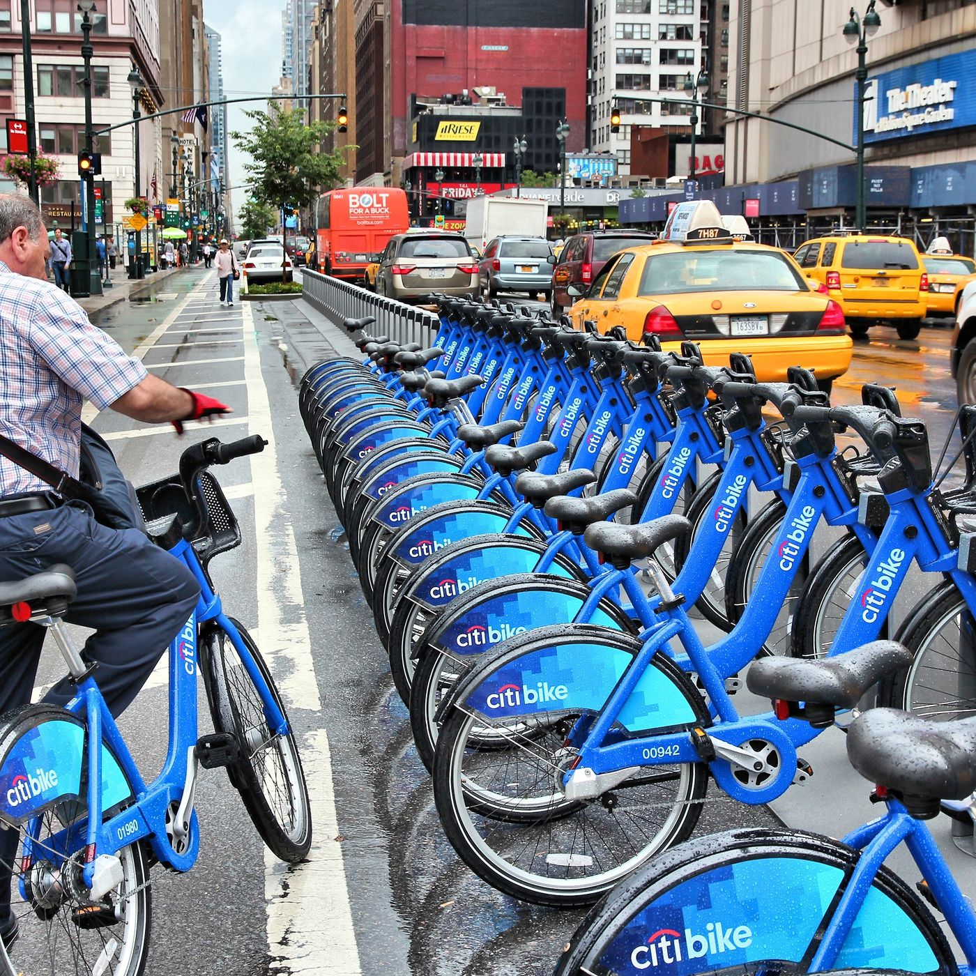
SHARING STRUCTURE

Slide 6
PROBLEM STATEMENT
Request For Development Of Group One Bike Share Dashboard
We need your expertise to develop a dashboard for “Group One Bike Share” that displays our key metrics for informed decision-making.
Requirements:
Hourly Revenue Analysis
Profit and Revenue Trends
Seasonal Revenue
Riders Demographics
Data Source: Access to our databases will be provided.
Please provide an estimated timeline for completion and recommendation on raising price next year.
Best regards,

Slide 7



PROJECT OBJECTIVE
Hourly Revenue Analysis &
Profit and Revenue Trends
Seasonal Revenue
&
Riders Demographics
Recommendation on raising price next year
Analyze hourly revenue patterns, assess profit trends, and evaluate revenue growth over time to identify peak periods, optimize operations, and inform strategic financial decisions
Analyze seasonal revenue patterns and rider demographics to optimize service allocation, marketing strategies, and operational efficiency for targeted growth and customer satisfaction
Evaluate market conditions, cost trends, demand elasticity, and competitor pricing to recommend optimal price adjustments for maximizing profitability while maintaining customer retention and market competitiveness

Slide 8
OUR DATA ANALYSIS WORKFLOW
Created a Database
Developed SQL Queries
Connected Power BI to Database Queries
Cleaned Out dataset in Power BI
Built Dashboard in Power BI
Answered the Problem Statement

Slide 9
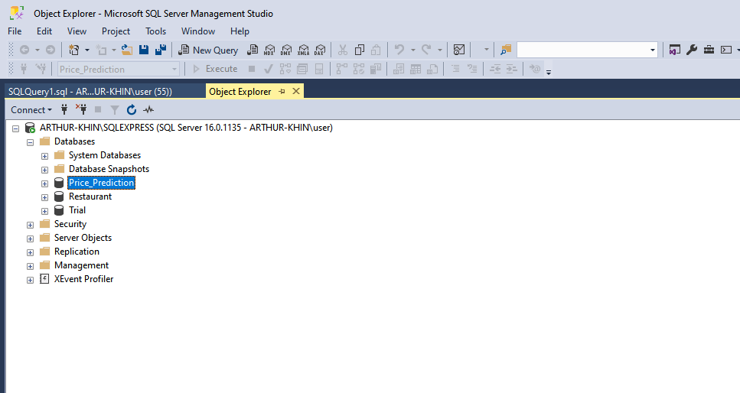
CREATION OF DATABASE

Slide 10
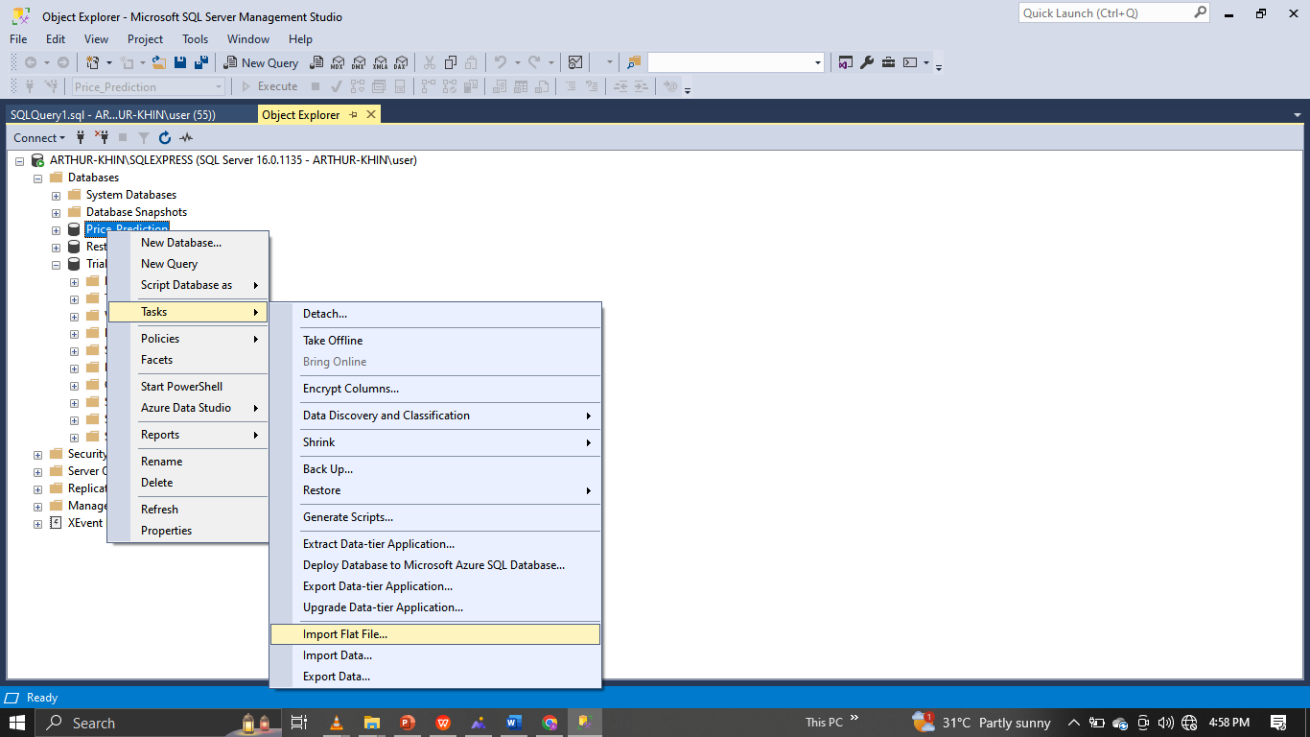
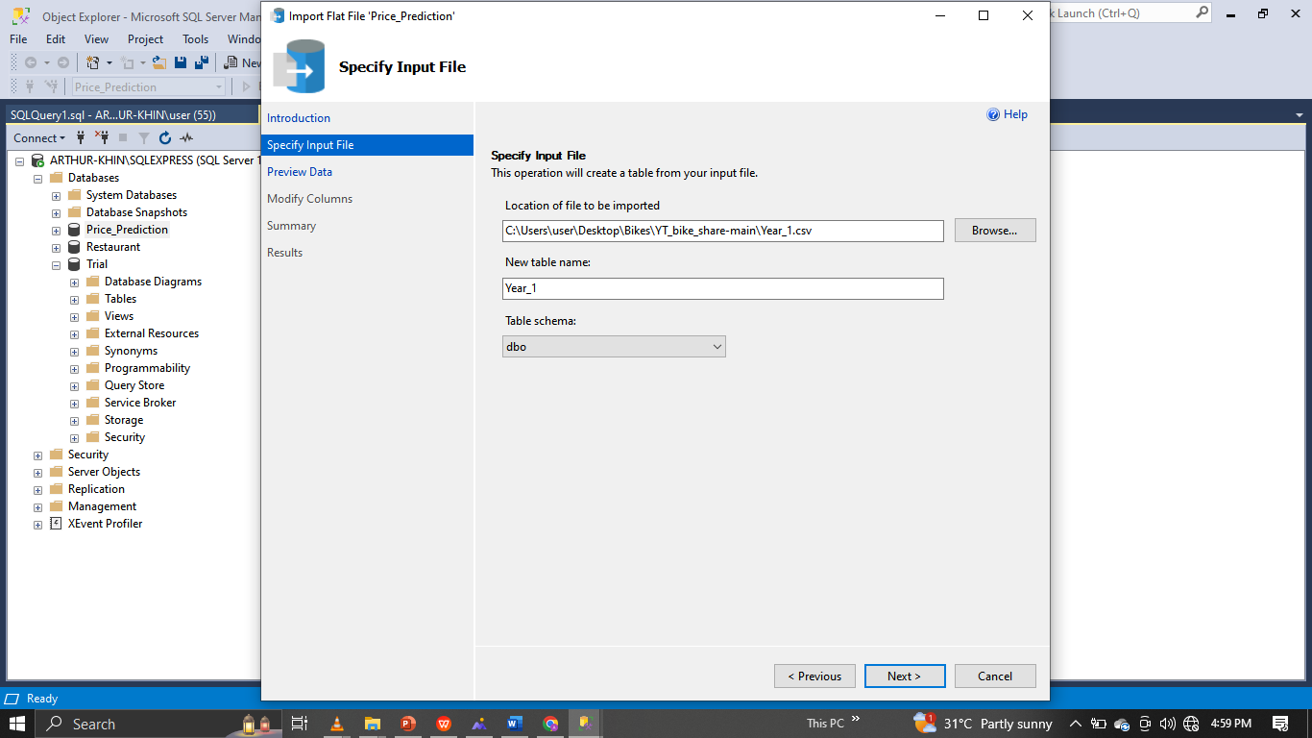
Import Process

Slide 11
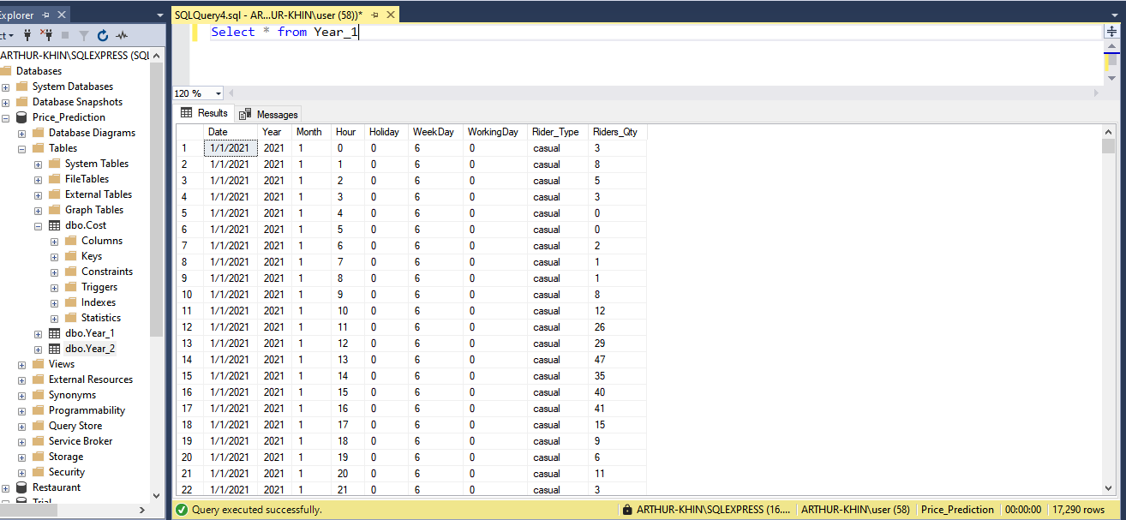
First year table

Slide 12
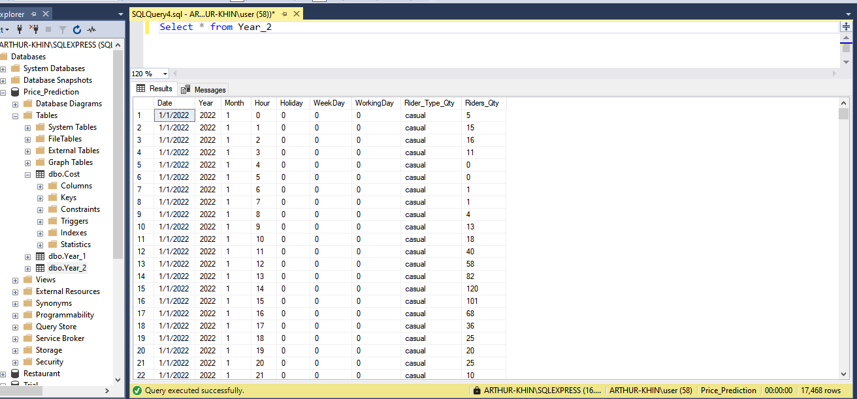
second year table

Slide 13
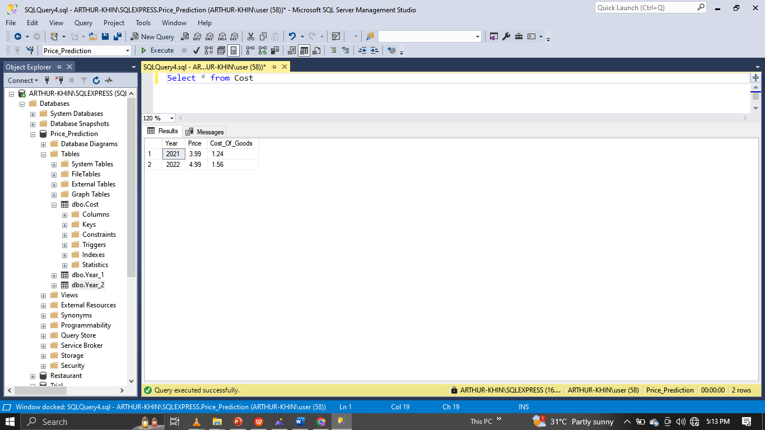
cost table

Slide 14
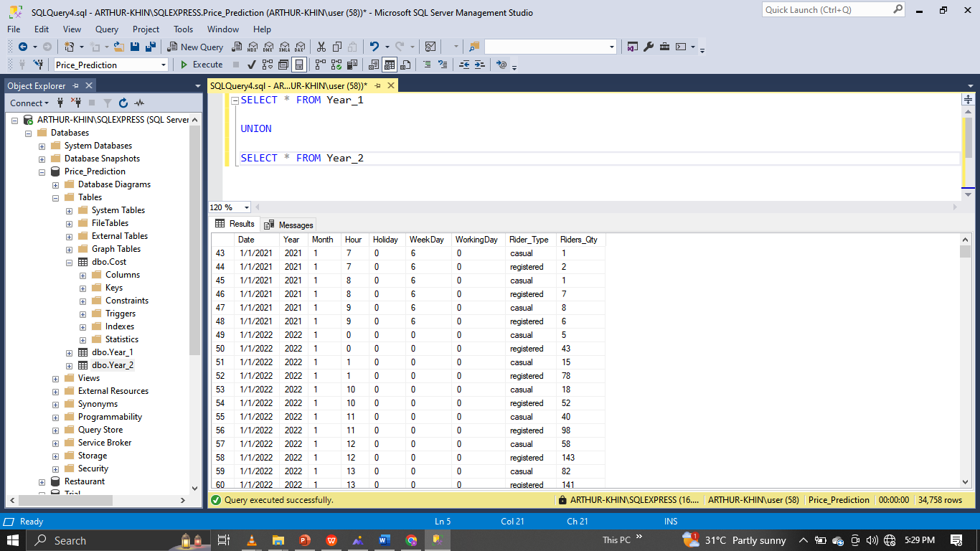
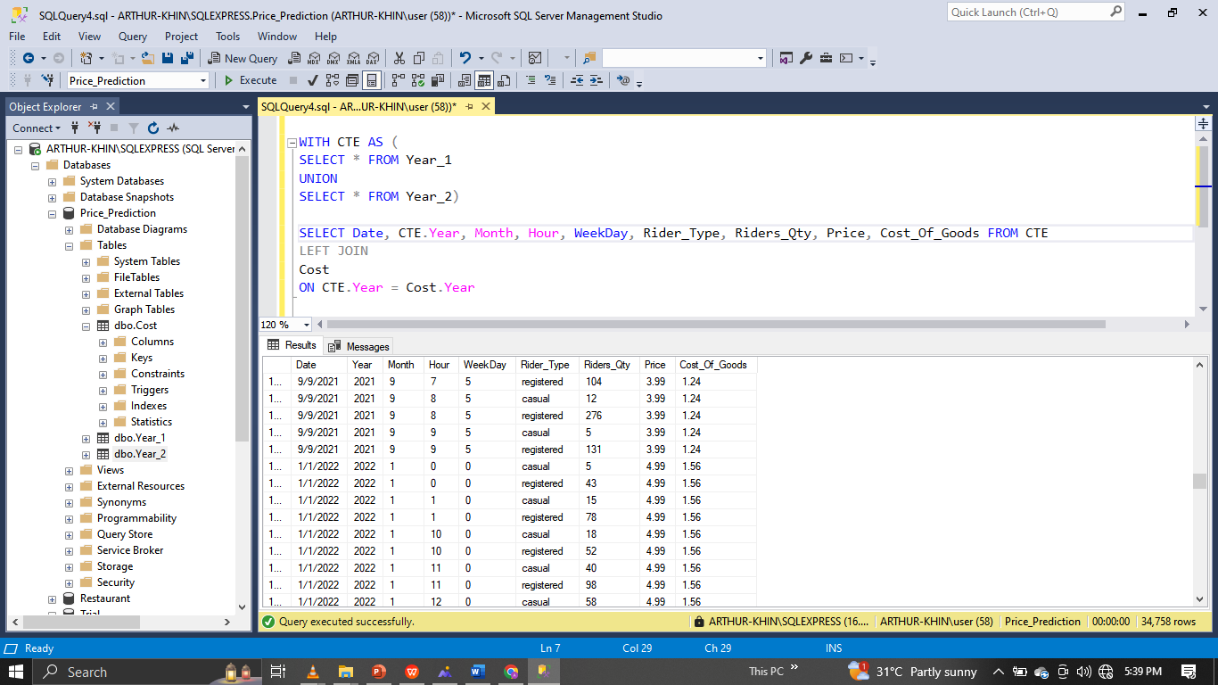
SQL QUERIES
Merging The Year Tables
Left-Joining Cost To Year Tables

Slide 15
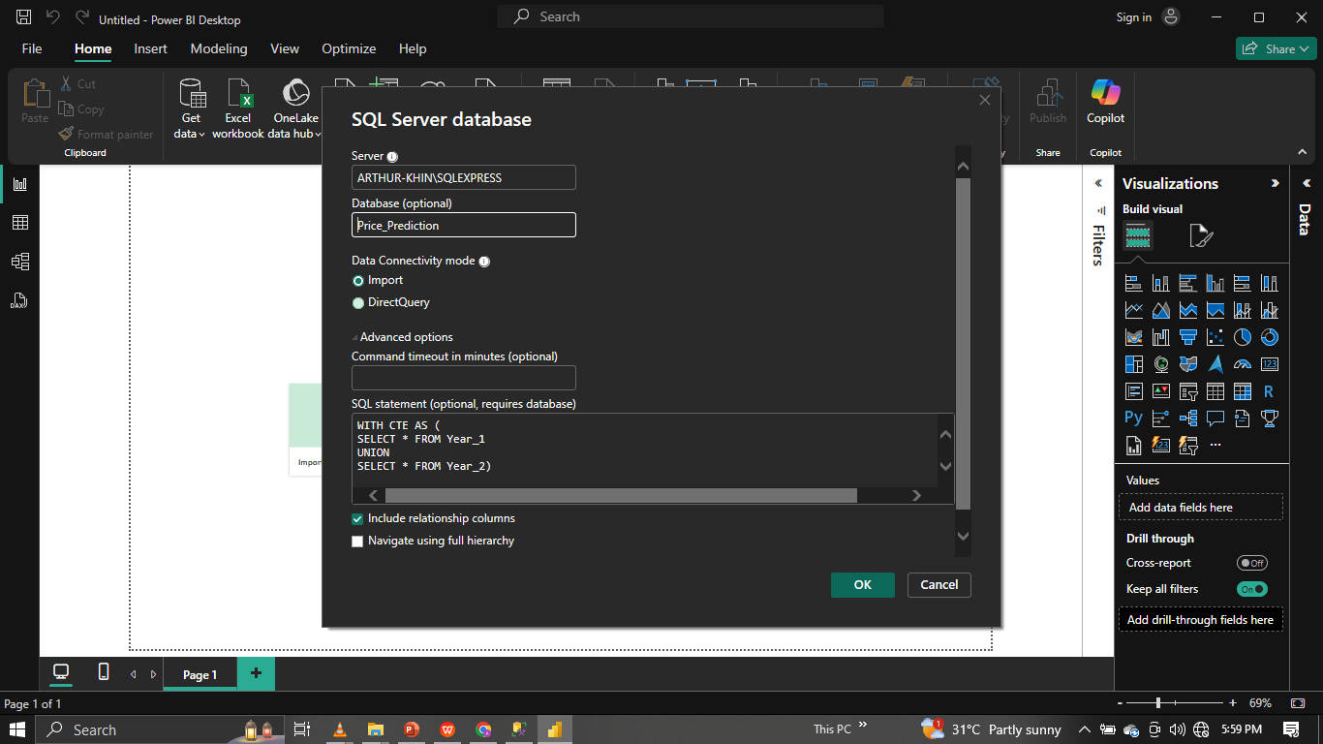
Connecting database query to power bi

Slide 16
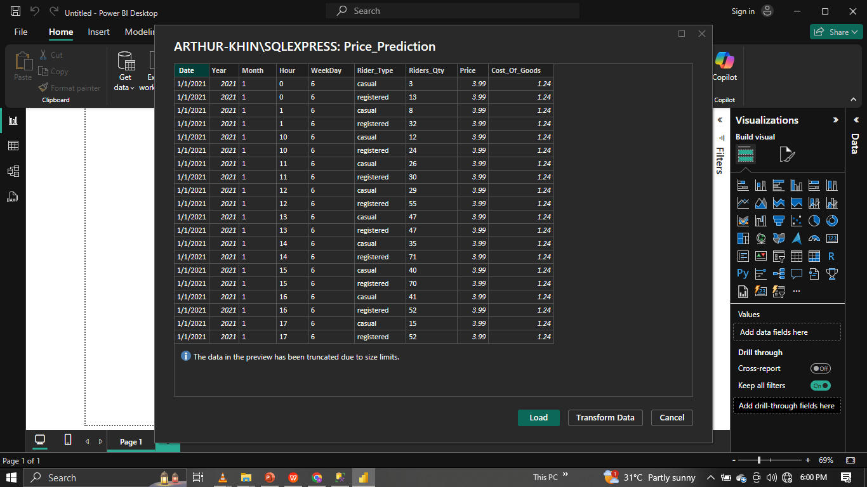
Cleaning out dataset in power bi

Slide 17
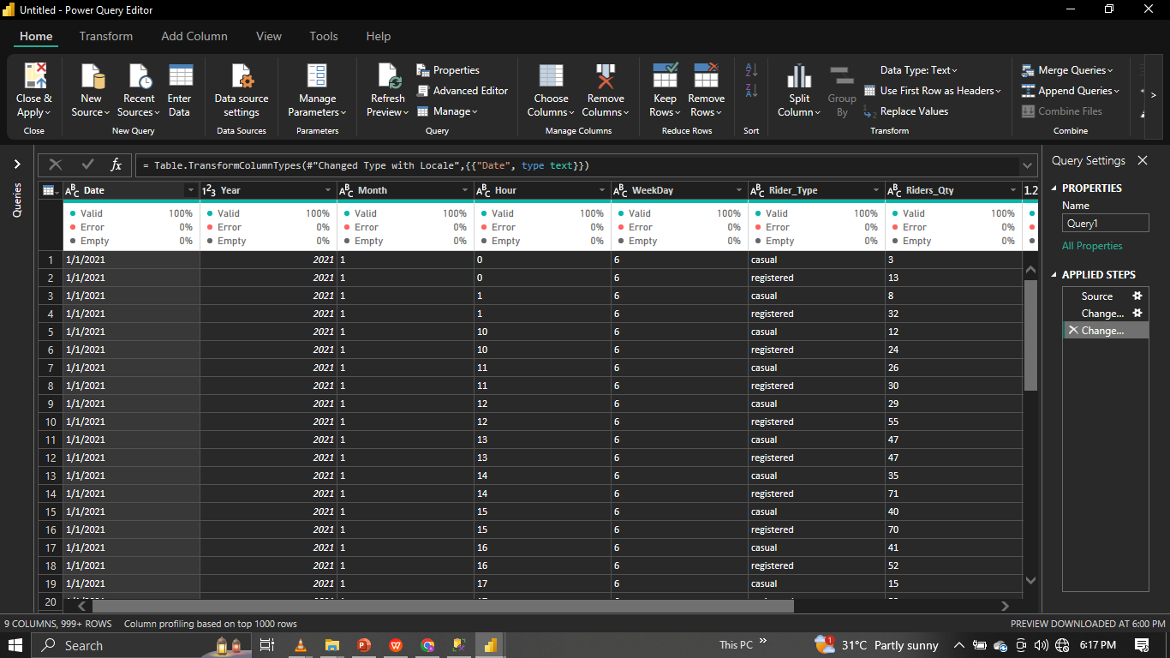
Cleaning out dataset in power bi

Slide 18
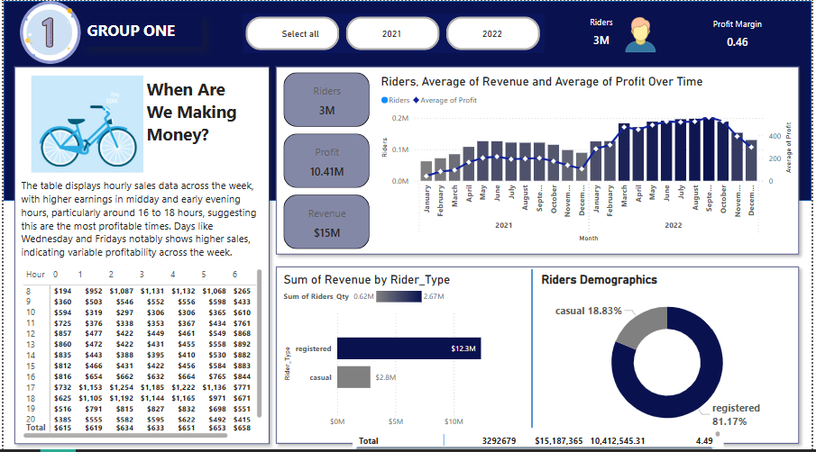
dashboard with power bi

Slide 19
Team recommendation
Considering the substantial increase last year, a more conservative increase might be prudent to avoid hitting a price ceiling where demand starts to drop. An increase in the range of 10% - 15% could test the market’s response without risking a significant loss of customers.
Price Setting:
Looking at price in 2022 which is 4.99, a 10% increase would make the new price about 5.49.
A 15% increase would set the price at approximately 5.74
Recommended Strategy:
Conduct further market research to understand customer satisfaction.
Consider different pricing for casual and registered users.
Implement the new prices but be ready to adjust based on immediate customer feedback and sales data.

Slide 20
Thank you…

